Slide 1
CPSC3300: Computer Systems Organization
Lecture 11 – Pipeline Datapath

Slide 2
Administrivia
Project 1
Due February 26
HW3
Available online, due Tuesday March 9
Reading
Chp 4.4-6

Slide 3
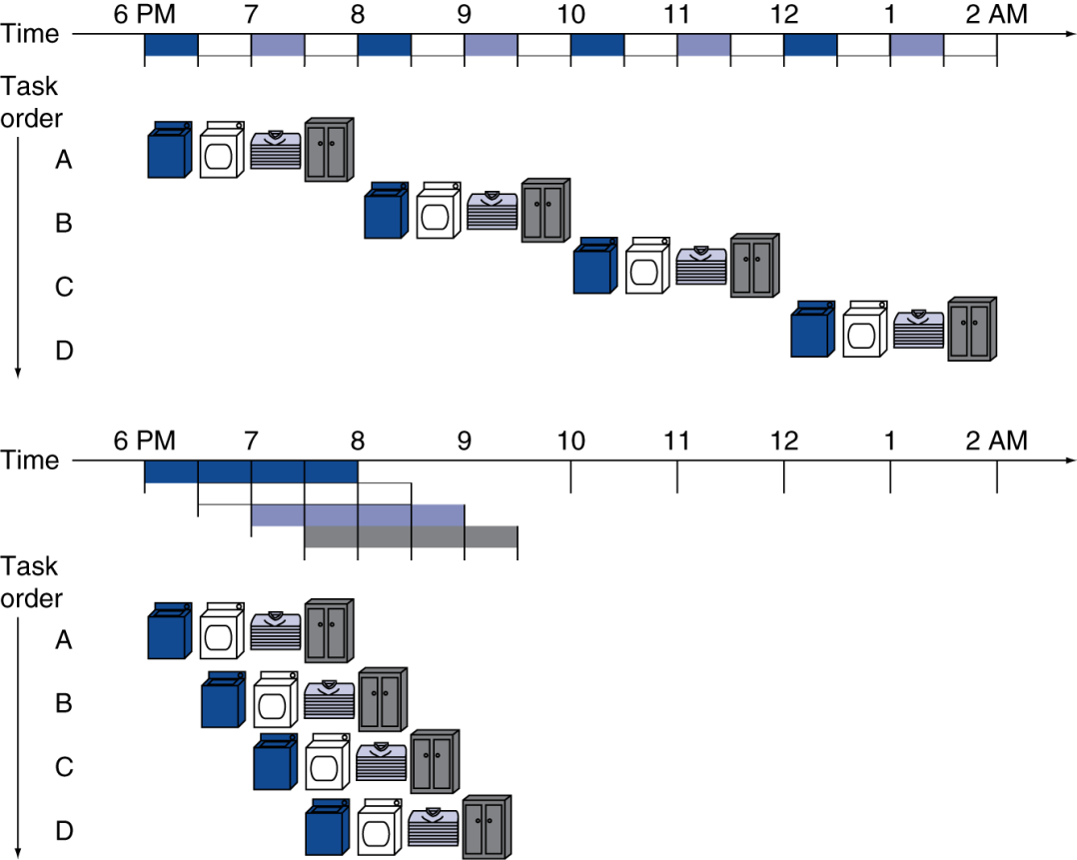
Pipelining Analogy
Pipelined laundry: overlapping execution
Parallelism improves performance
Four loads:
Speedup = 8/3.5 = 2.3
Non-stop:
Speedup = 2n/(0.5n + 1.5) ≈ 4 = number of stages

Slide 4
MIPS Pipeline
Five stages, one step per stage
IF: Instruction fetch from memory
ID: Instruction decode & register read
EX: Execute operation or calculate address
MEM: Access memory operand
WB: Write result back to register

Slide 5
Pipeline Performance
Assume time for stages is
100ps for register read or write
200ps for other stages
Compare pipelined datapath with single-cycle datapath
Instr | Instr fetch | Register read | ALU op | Memory access | Register write | Total time
lw | 200ps | 100 ps | 200ps | 200ps | 100 ps | 800ps
sw | 200ps | 100 ps | 200ps | 200ps |  | 700ps
R-format | 200ps | 100 ps | 200ps |  | 100 ps | 600ps
beq | 200ps | 100 ps | 200ps |  |  | 500ps

Slide 6
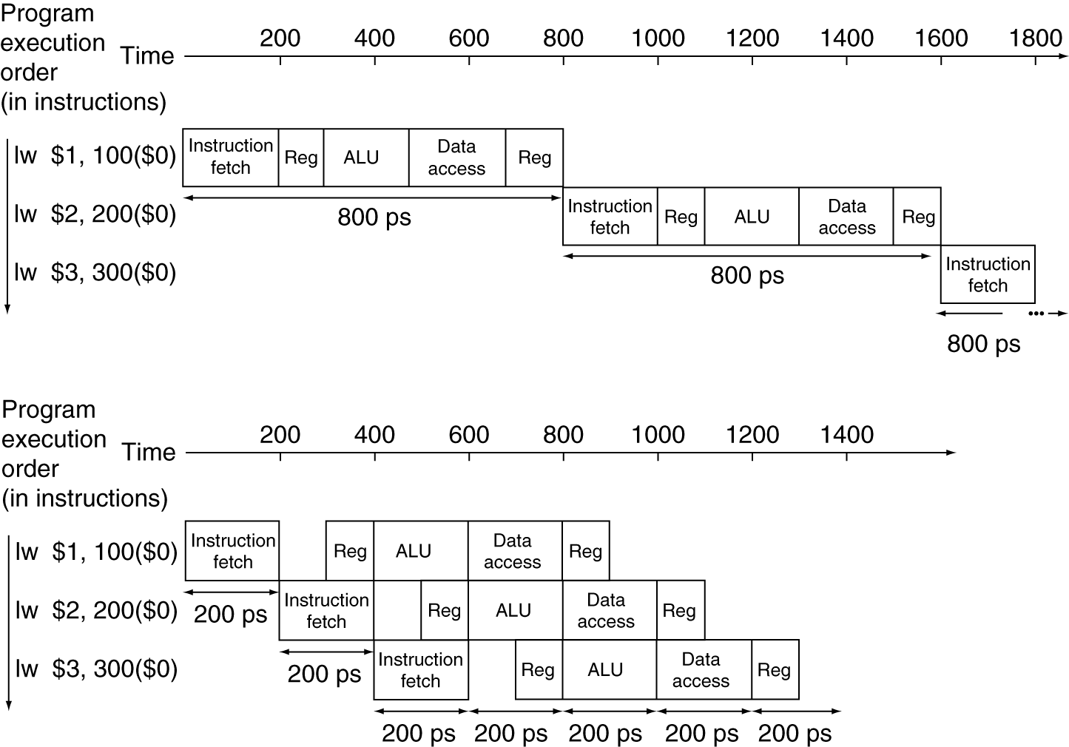
Pipeline Performance
Single-cycle (T_{c}= 800ps)
Pipelined (T_{c}= 200ps)

Slide 7
Pipeline Speedup
If all stages are balanced
i.e., all take the same time
Time between instructions_{nonpipelined}
Time between instructions_{pipelined}
= Number of stages
If not balanced, speedup is less
Speedup due to increased throughput
Latency (time for each instruction) does not decrease

Slide 8
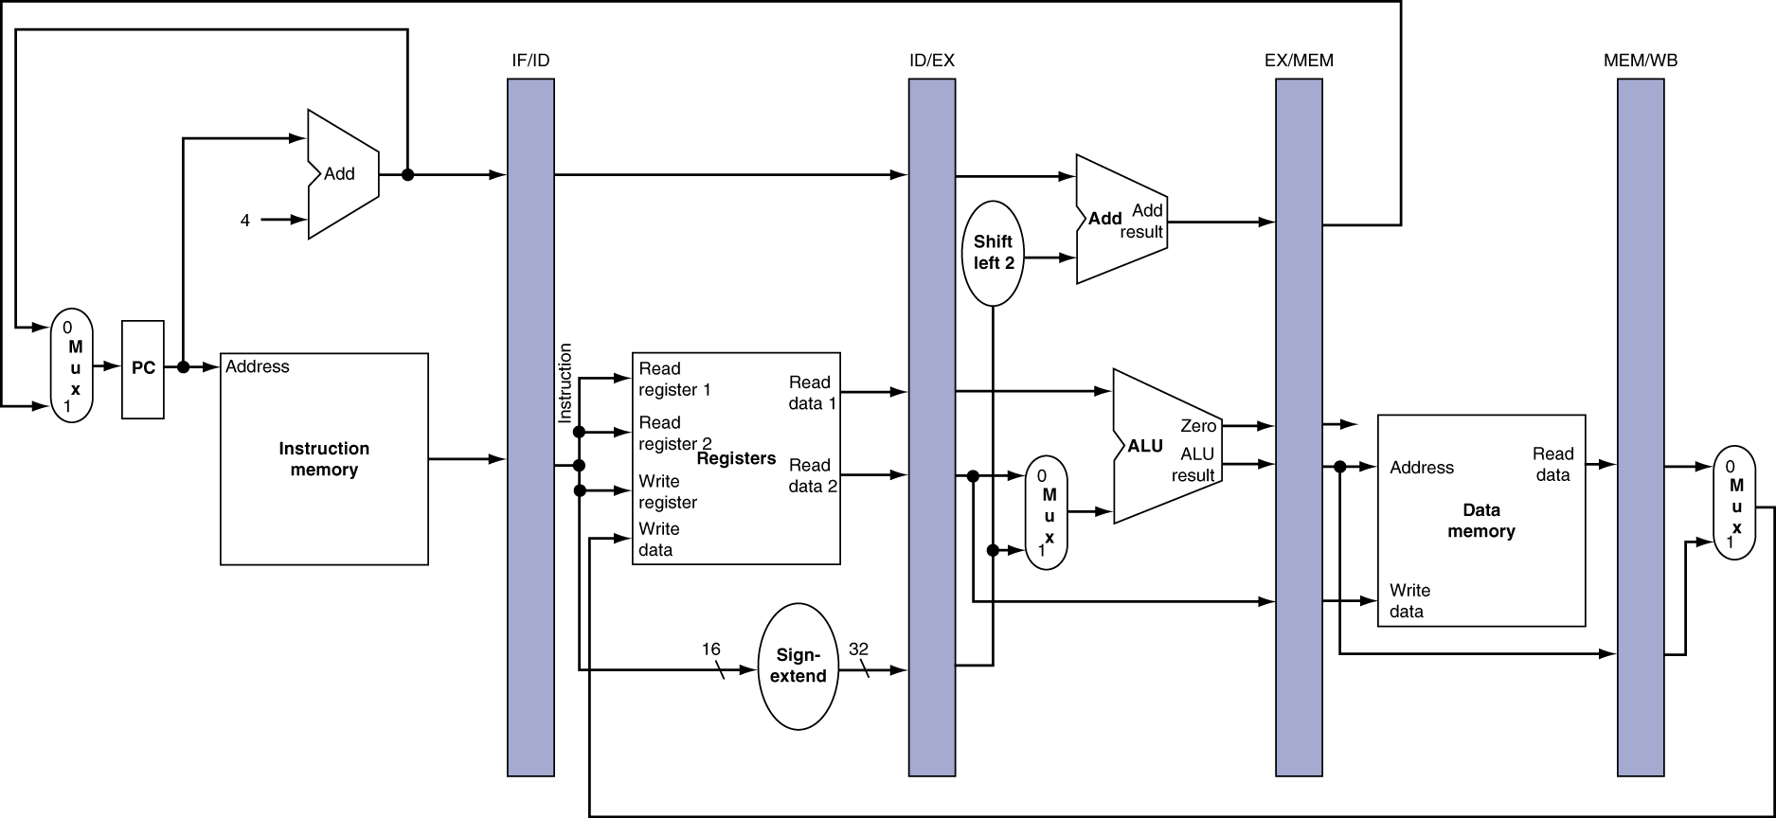
Pipeline registers
Need registers between stages
To hold information produced in previous cycle

Slide 9
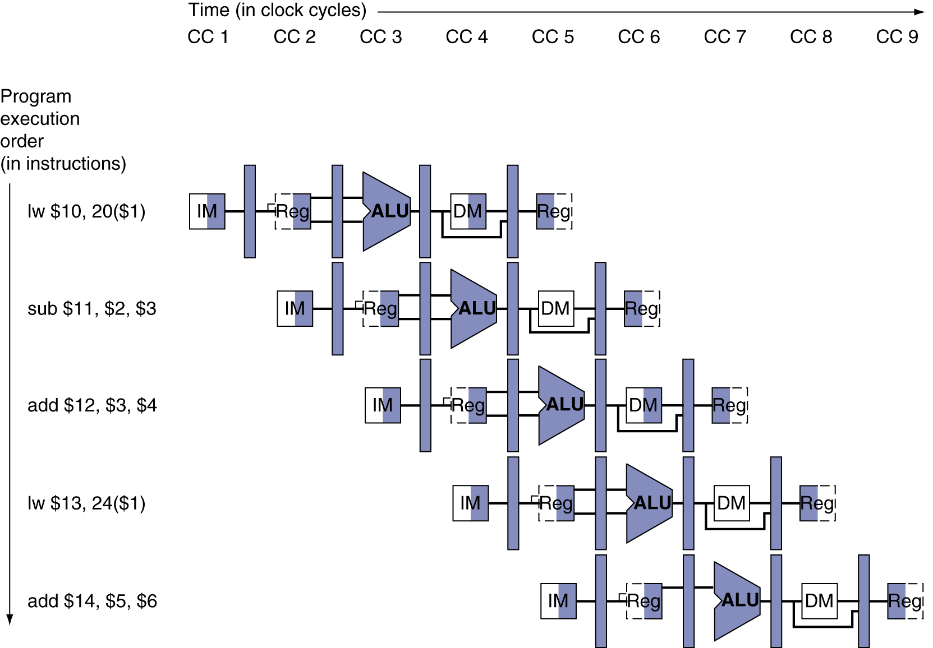
Multi-Cycle Pipeline Diagram
Form showing resource usage

Slide 10
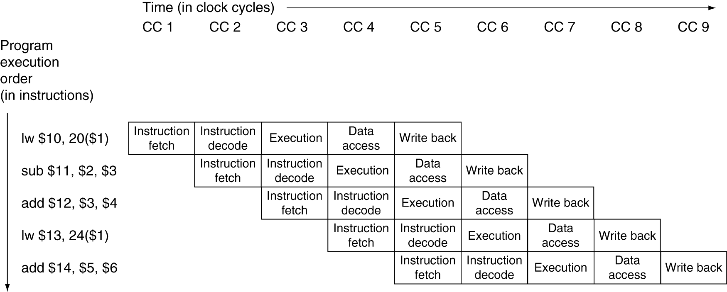
Multi-Cycle Pipeline Diagram
Traditional form

Slide 11
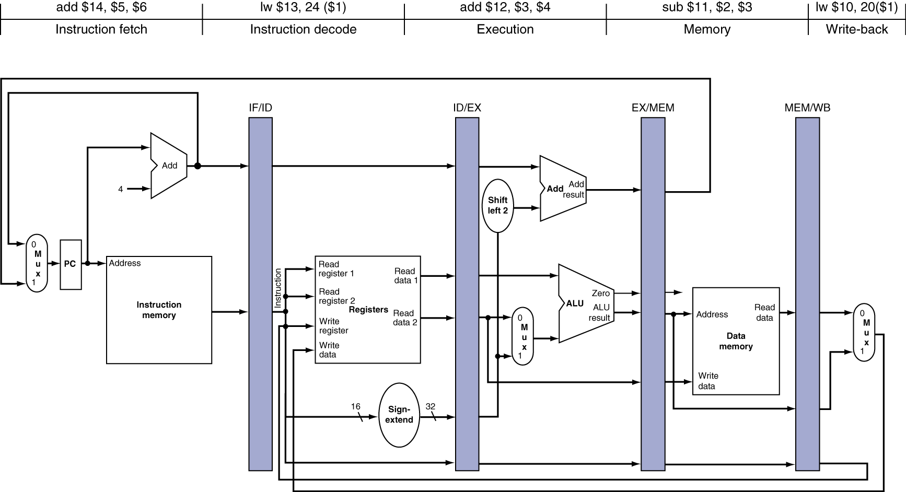
State of pipeline in a given cycle

Slide 12
Data Hazards in ALU Instructions
Consider this sequence:
sub $2, $1,$3 and $12,$2,$5 or $13,$6,$2 add $14,$2,$2 sw $15,100($2)
We can resolve hazards with forwarding
How do we detect when to forward?

Slide 13
Pipeline Data Hazard Types
Pipeline hazard occurs when dependence exists and instr’s are close enough that instr overlap changes operand access order
Named by “ordering that must be preserved”
Types of data hazards (i followed by j)
Read After Write (RAW) (aka true dependence)
j tries to read operand before i writes it
Write After Read (WAR) (Antidependence, a)
j tries to write operand before i reads it
Write After Write (WAW) (Output dependence, o)
j tries to write operand before i writes it
Read After Read (RAR) (Input dependence, i)
i and j read the value of some variable

Slide 14
RAW
RAW hazard: later instruction tries to read an operand before earlier instruction writes it
The dependence
add R1, R2, R3
sub R5, R1, R4
The hazard
IF | ID | EX | MEM | WB
IF | ID | EX | MEM | WB

Slide 15
WAW
WAW hazard: later instruction tries to write an operand before earlier instruction writes it
The dependence
add R1, R2, R3
sub R1, R2, R4
The hazard
WAW hazard possible in a reasonable pipeline, but not in the very simple pipeline we are assuming
IF | ID | EX | MEM1 | MEM2 | MEM3 | WB
IF | ID | EX | MEM | WB

Slide 16
Interlocks
When threatened by a hazard
Stall (pause a part of the pipeline by inserting no-op)
Stalling avoids overlap that would cause error
Stalling slows things down
Add hardware to avoid the hazards
Details of hardware depend on hazard and pipeline

Slide 17
Data Dependence Graph
Main data structure: dependence DAG
Nodes represent instructions
Edges (s1,s2) represent dependences between instructions
Instruction s1 must execute before s2
Sometimes called data-flow graph

Slide 18
Dependence Graph Example
Sample code
sub $2, $1,$3
and $12,$2,$5
or $13,$6,$2
add $14,$2,$2
sw $15,100($2)
1
RAW
RAW
RAW
2
3
4
RAW
5

Slide 19
Dependence Graph Example
Sample code
sub $2, $1,$3
and $12,$2,$5
or $12,$6,$2
add $6,$2,$2
sw $15,100($2)
1
2/RAW
2/RAW
2/RAW
2
3
4
12/WAW
6/WAR
2/RAW
5

Slide 20
Data Dependence Graph Example
Data Dependence Graph
S1 ADD R1, R2, R3
S2 BEQZ R1, L1
S3 ADD R4, R2, R5
S4 ADDI R5, R4, 1
S5 L1:ADDI R4, R5, 2
S1
i
R1/RAW
i
S2
o
a
a
i
S3
R4/RAW
a
o
S4
i
R5/RAW
a
S5

Slide 21
Summary
MIPS pipeline
Single cycle graph
Pipeline multiple cycle graph
Data dependence and data dependence graph

